Slide 1

2019-2020
Malware-Detector
for Android applications
Bachelor In Computer Science
ACHTATOU Sean
University of Luxembourg

Slide 2
Project
With the beginning of the network, big amount of information and personal data are being transfered everyday. Thus nowadays, security need to be improved days after days in order to avoid possible sensible data leaks, which could be desastreous.
Types of devices used in the worldwide :
Personal Computer (PC)
Laptop
Smart-Devices
Smartphones
Goal of this project :
Develop a malware-detector (App-MD) for Android applications
Develop an Android application. (optional) (App-BICS)
Domains studied :
Android
Apps (Android Applications)
Reverse Engineering
Malwares
Artificial Intelligence

Slide 3


Android
Android is an operating system based Linux, used for mobiles devices- smartphones. It has been developed by the Google company and launched in 2007.
Particularities :
Provide a highly secured environment for the apps and its system
Virtual-Machine
Least-privilege
Virtual-Machine Dalvik
Multiples versions

Slide 4


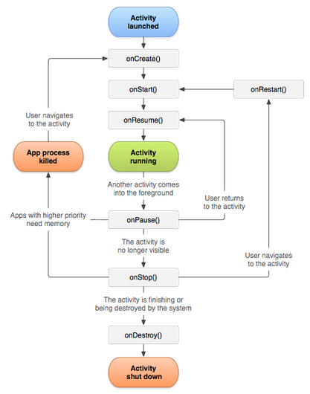
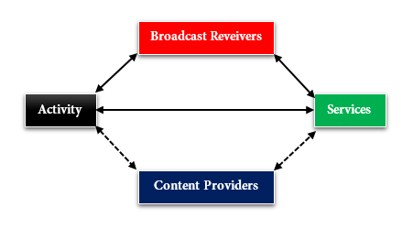

Apps – Android Applications
An app is an « executable » which can be installed and ran on Android devices.
Particularities :
The extension is of the form « .apk » (Android Package)
There exists « .xapk » (Out of the scope)
Composed of multiples components in order to be operational
Programmable in Java, C++, Python
Components of an app :
Activity – activity life cycle
Services – started services/bound services
Broadcast Receivers
Content Providers (Out of the scope)
Activity life cycle :
onCreate()
onStart()
onResume()
onPause()
onStop()
onRestart()
onDestroy()

Slide 5
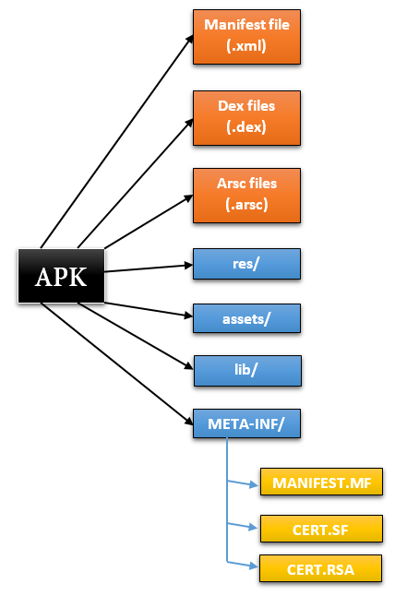
Apps - Decomposition
Structure of an app :
Manifest.xml (information of the app such as the name, version, permissions used, features of the device used)
.dex (compiled Java code converted intot dalvik code – dalvik executable)
.arsc (pre-compiled app ressources in xml structure)
res/ (not-compiled app ressources)
assets/ (app assets)
lib/ (compiled code of the native libraries)
META-INF/ - MANIFEST.M`F¬CERT.SF¬CERT.RSA
Details of the Manifest file :
Manifest tag
<permissions>
<use-features>
<application>
<activity>
<services>
<receivers>
<intent-filter>

Slide 6

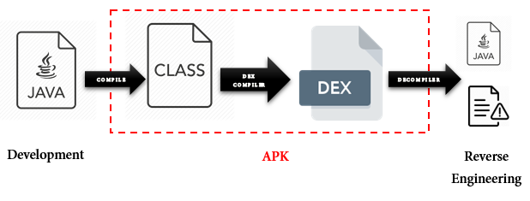


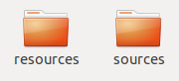
Reverse Engineering
The Reverse engineering is a technique allowing to decompile applications which have been developed and compiled by developers.
Different types of tools for reverse engineering :
ApkTool
Androguard
dex2Jar
Javasnoop
Valgrind
JADX
…
Reverse Engineering on Android application provide two folders :
Ressources
Sources

Slide 7

Malwares
A malware is a malicious application developed in order to retrieve personal data, or manipulate the device of users, and benefit from it.
Malware techniques :
Installation (repackage, update attack, fake apps,…)
Activation (BOOT_COMPLETED, triggered by an event or an action)
Payloads (remote control, financial charge, information collection,…)
Additional Techniques (shadow payloads, obfuscation, anti-analysis,…)
We have manually analyzed multiples Malwares techniques and code, in order to retrieve possible malicious signature, which would be used for the analysis of Android applications with the App-MD.
Samples of malicious signature applied :
TelephonyManager
SmsManager
Base64.decode
getExternalStorageDirectory

Slide 8
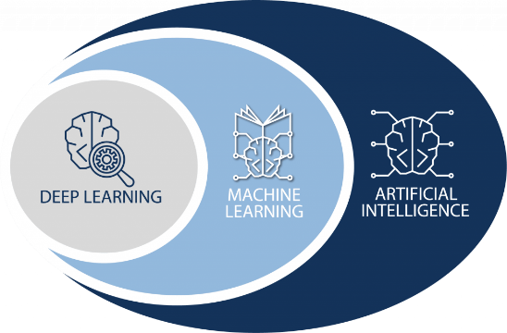
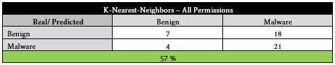
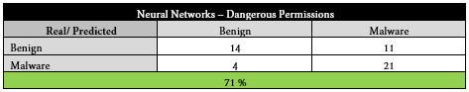
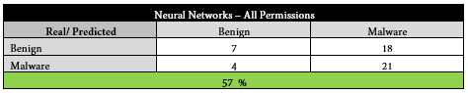
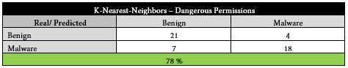
Artificial Intelligence – Machine Learning
Artificial Intelligence can be introduced in order to solve problems which are likely to be solvable using an automatic model, if the data to analyse is modified and hardly analysable manually.
We introduce four models :
K-Neirest-Neighbors – All permissions (Machine Learning)
Neural Networks – All permissions (Deep Learning)
K-Neirest-Neighbors – Dangerous permissions (Machine Learning)
Neural Networks – Dangerous permissions (Deep Learning)

Slide 9
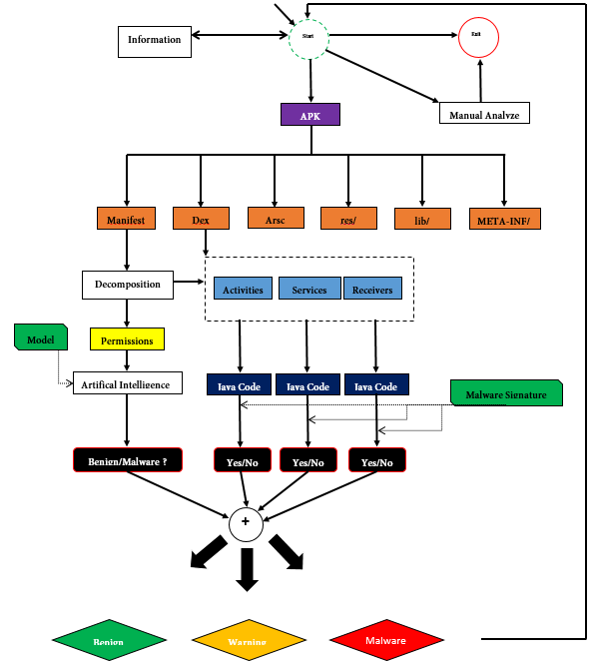
Application for malware-detector in Android Applications (App-MD)
Analysis flow :
Input of the app (only allowing extension .apk)
Possibility to analyse the app manually via an UI
Reverse engineering of the app (creation of a folder with the decompiled application)
Retrieve of the permissions in the manifest file
Retrieve of the codes based on the manifest file components structure and the .dex files.
Analysis of the permissions with the Machine Learning model (returns of a result being benign or malicious)
Analysis of the codes based on the malicious signature gathered manually (return of a percentage of matches)
From both of the analysis, returns a final percentage between 0 and 100, such that :
Benign ¬ <45%
Warning ¬ 45%<X<55%
Malware ¬ >55%

Slide 10
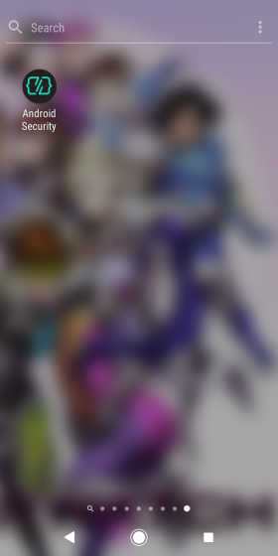
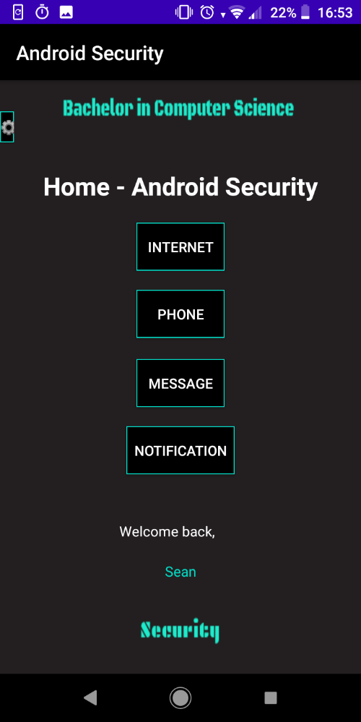
Results
Properties of App-MD :
Successfully classify 90% of the apps.
Only based on two analysis, nevertheless succesfully manage the classification of the apps
Can be used manually or automatically
Handle issues (missing files, reverse engineering un-successfull)
Only analyze .apk extension
Improvements :
Train the Artificial Intelligence models on thousands of apps.
Apply additional analysis about the information obtained from the reverse engineering of an app.
Possibility to analyse on .xapk extension
Properties of App-BICS :
Is a tiny benign application
Possibility to activate/de-activate WI-FI
Has been successfully classified by App-MD as benign

Slide 11
Thank you for your attention

